Slide 1
Simple Spring full-stack app
Boot + REST + JDBC Template + Testing

Slide 2
Цель
Собрать простое приложение с
Spring Boot
Embedded web-container для REST
JDBC Template
Возможность вызвать REST-сервис из другого приложения (RestTemplate)
Протестировать приложение
Интеграционные тесты между слоями (MVC

Slide 3
Запуск приложений для Web
*.war (web-archive)
c web.xml - конфигурация в xml
Демо 1а. Базовый веб-проект Servlets, JSP: Создаем и запускаем простой веб-проект в NetBeans
Демо 1б. Создаем простой Spring MVC проект в Idea
http://www.byteslounge.com/tutorials/first-spring-mvc-application-tutorial
Без web.xml – программная конфигурация
Это касается всех веб-приложений, не только Spring MVC
Spring MVC: https://kielczewski.eu/2013/11/spring-mvc-without-web-xml-using-webapplicationinitializer/

Slide 4
Запуск с помощью Spring Boot
Embedded web-container
Convenient logger
Convenient property files ( application.properties) for externalizing configuration
jar / war packaging

Slide 5
С чего начать
Spring initializer
http://start.spring.io
Web
Lombok

Slide 6
@SpringBootApplication
@SpringBootApplication
@Configuration
@ComponentScan
@EnableAutoConfiguration - Spring Boot auto-configuration attempts to automatically configure your Spring application based on the jar dependencies that you have added.

Slide 7
Making first REST service
REST service for User
User class with Lombok
*enable in Intellij Idea Annotation Processing

Slide 8
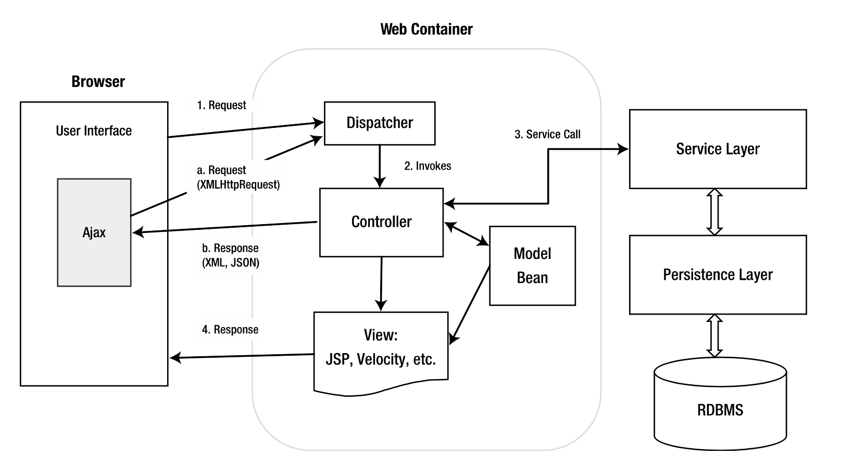
Spring MVC

Slide 9
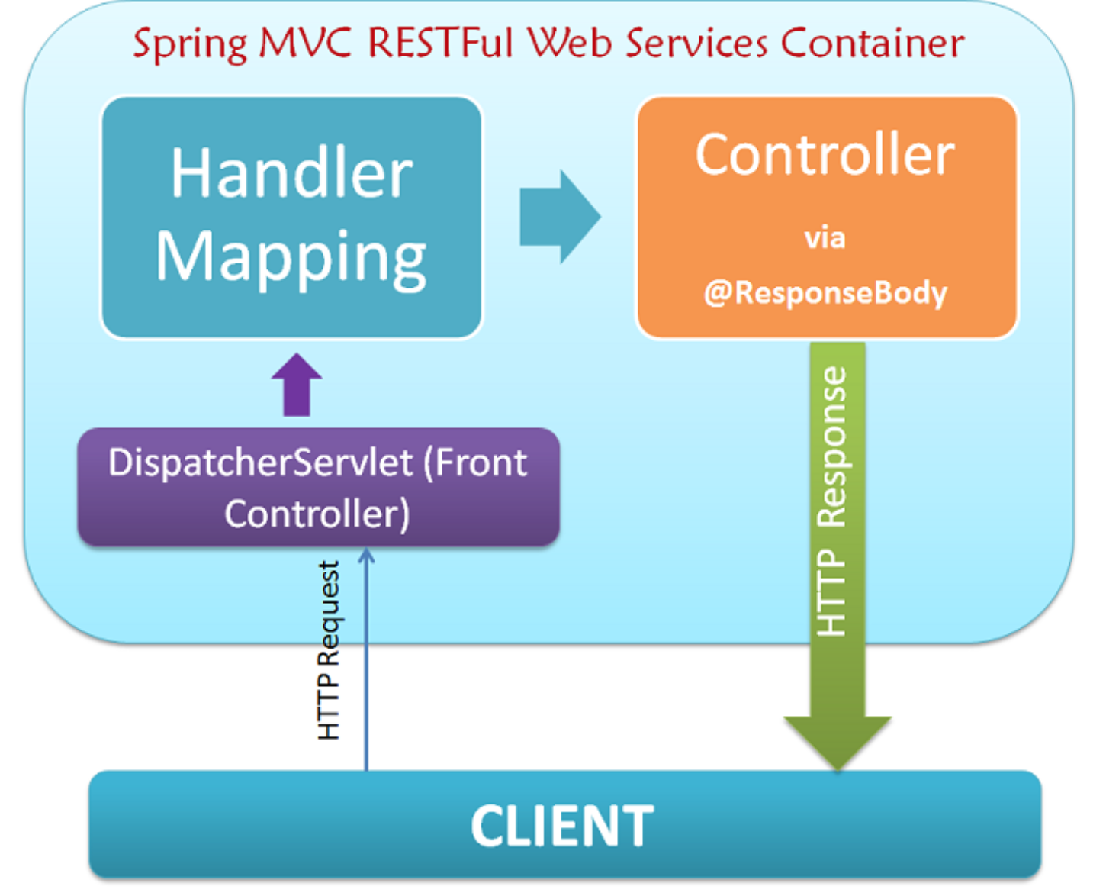
Spring MVC RESTFul

Slide 10
SpringRestApp
DIY
Open project from https://github.com/sirotae/SpringLesson2/tree/master/SpringRestApp
Project contains
REST
Fake DAO
Integration tests for REST via MockMvc

Slide 11
Integration Testing of REST
Add to gradle/maben Test dependency org.springframework.boot:spring-boot-starter-test
Use MockMvc to test app (see UserControllerTest)
Mock your beans (mock UserDao in MockConfig.java)
It will allow to test UserController when mocked UserDao is created by Spring Application Context

Slide 12
Working with data

Slide 13
Variety of methods
JDBC
Spring JDBCTemplate
JPA
Spring Data

Slide 14
JDBC examples
public static void main(String args[]) {
try {
String url = "jdbc:oracle:thin:@//10.18.80.10:1521/CASE";
String user = ""; // указать имя
String password = ""; // указать пароль
Connection con = DriverManager.getConnection(url, user, password);
System.out.println("CONNECTED TO ---> " + url);
Statement stmt = con.createStatement();
String qry = "SELECT * FROM Customer ORDER BY cust_name";
ResultSet rs = stmt.executeQuery(qry);
System.out.println("EXECUTED QUERY ---> " + qry);
// Print the results, row by row
System.out.println("\nPROCESSING RESULTS:\n");
while (rs.next()) {
System.out.println(
" SSN :" + rs.getString("ssn").trim());
System.out.println(
" NAME :" + rs.getString("cust_name").trim());
System.out.println(
" ADDRESS: " + rs.getString("address").trim());
System.out.println("");
}
rs.close();
stmt.close();
con.close();
} catch (SQLException e) {
e.printStackTrace();
}
}

Slide 15
Simple Real life scenarios
Connection Pool
Data Source (with connection pool & tx)
Spring JDBC Template will help
Encapsulate connection pools
Conveniently maps ResultSets to your objects

Slide 16
Spring Boot Magic - DataSource
Spring comes with out of the box DataSource implementation
DataSource instance is created automatically based on application.properties when needed
Datasource can be overridden programmatically (you can create you’re your own bean)

Slide 17
Testing of JDBC Template
public class UserDaoTest { private UserDao dao; @Before public void setUp() { EmbeddedDatabase db = new EmbeddedDatabaseBuilder() .setType(EmbeddedDatabaseType.HSQL) .generateUniqueName(true) .addScript("dao/data.sql") .build(); dao = new UserDao(new JdbcTemplate(db)); } @Test public void read() throws Exception { List<User> list = dao.findAll(); assertEquals(1, list.size()); assertEquals("EmbeddedUserName", list.get(0).getName()); } }

Slide 18
SpringRestDBApp
DIY
Open project from https://github.com/sirotae/SpringLesson2/tree/master/SpringRestDBApp
Project built on the top of SpringRestApp
Project contains
REST
DAO, PostgreSQL
Integration tests for DAO (embedded DB)

Slide 19
Домашечка
Full-stack app with REST & JDBC Template + Testing!

